Slide 1
EdTech - Needfinding
Week 1

Slide 2


Our Team
Jake Ray
Fiona Hall-Zazueta
Eli Vazquez
David Rathmann-Bloch
Notes:
CLICK ON THE IMAGE ABOVE YOUR NAME AND REPLACE IMAGE WITH YOUR PREFERED PROFILE PIC

Slide 3
Domain
How instructors use technology in classrooms and learning environments

Slide 4
Methodology
Finding Interviewees:
Students
Professors
Extreme Users: 5 year old student, Preschool teacher, technology director
Interview Order + Strategy:
Background & Interests → Tech Experiences → Pain points & wishes/needs

Slide 5
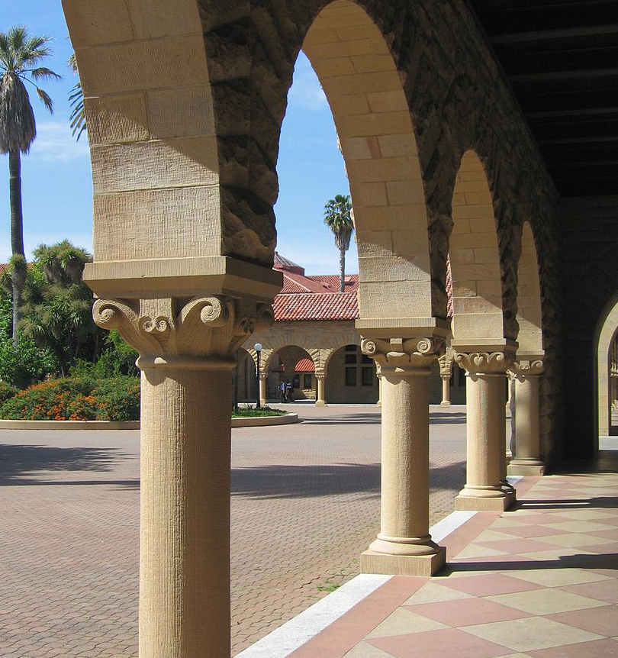
Location and Compensation
Image Source: https://commons.wikimedia.org/wiki/File:Stanford_University_Arches_of_the_Quad_2.jpg

Slide 6
Questions
What is your schedule like? Do you have a personal computer ? A mobile phone?
What are your hobbies? What sort of tech do you use in the classroom?
What are some successes you have had with tech in the classroom?
What is technology you find frustrating to use?
And of course . . . Pulling threads and following up emotions and stories!

Slide 7
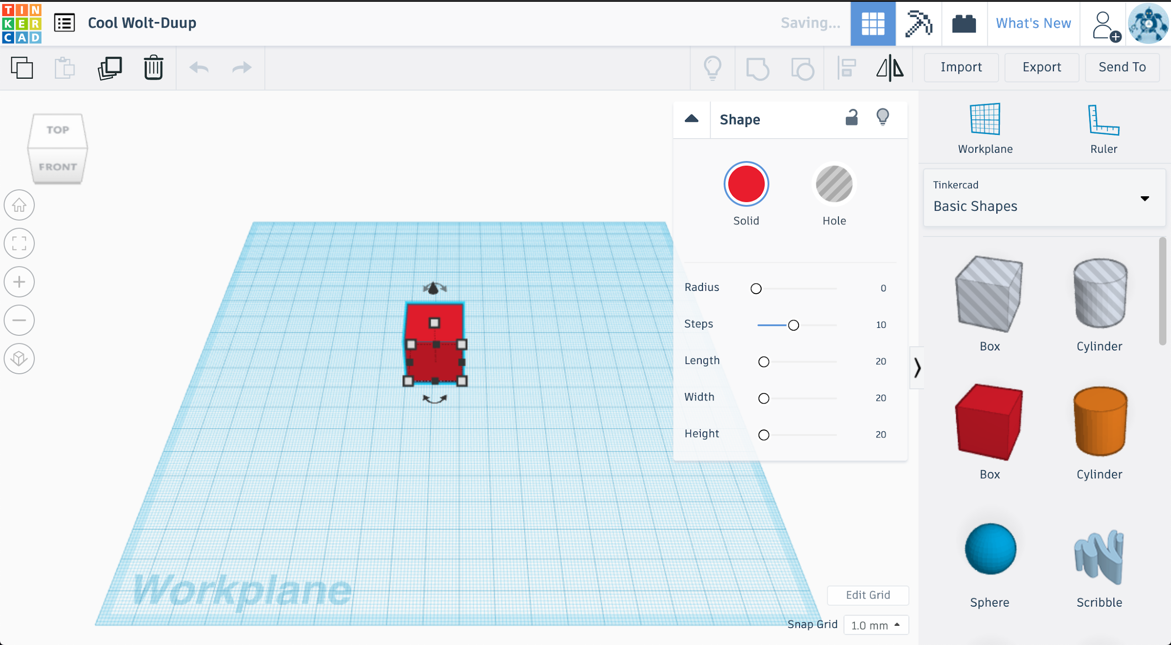

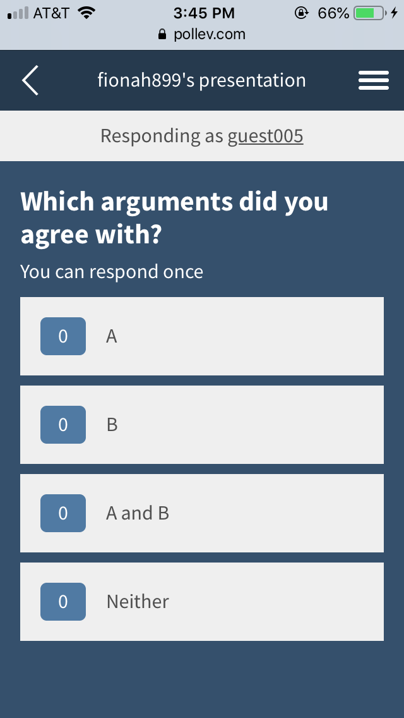
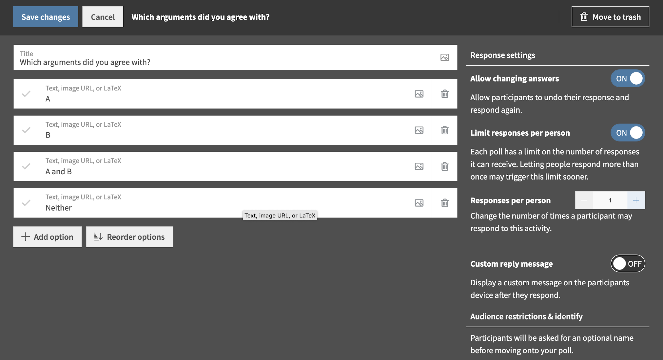



Slide 8
Bob
Semi-retired programmer studying quantum mechanics and VR programming online
(Middle age, white male)
Notes:
Participant Profile Slide
David’s dad

Slide 9
“The gold standard is something that makes me smarter.”

Slide 10
Say
Think
“The gold standard is something that makes me smarter.”
Found original quantum mechanics course from college more confusing, enjoyed being able to return to subject matter online.
VR GUI tutorials are “dry as dust.” Teaching people to use GUIs could be hugely improved by more interesting delivery and more standardized UI configurations.
Lonely; wishes he had more interaction with other students and TAs
Learned about quantum mechanics from Stanford online
Using Unity’s paid tutorials to develop a VR application.
Intellectually fulfilled by physics course
Works at home on his laptop
Grateful for free, high-quality content
Do
Feel
Notes:
Surprise: user revelation

Slide 11
John & Mark
5 year old, white, male, student
& 10 year old, white, male student
Notes:
Participant Profile Slide

Slide 12
“It’s really really interesting to find out what you can make.”

Slide 13
Say
Think
“I don’t have computers, I don’t do work”
Associates having a computer with having job/homework
“It’s really really interesting to find out what you can make. ‘Cause every time I use it I find out something else that you can do with it.”
It’s more impressive to do work in your head / without reviewing
Uses Tinkercad to do 3D modeling online
Likes exploring and discovering new features
Spelled out his name after telling it to me
Proud of learning, wants to share it
Do
Feel

Slide 14
Gabriel
Middle age, white, male, humanities professor
Notes:
Participant Profile Slide

Slide 15
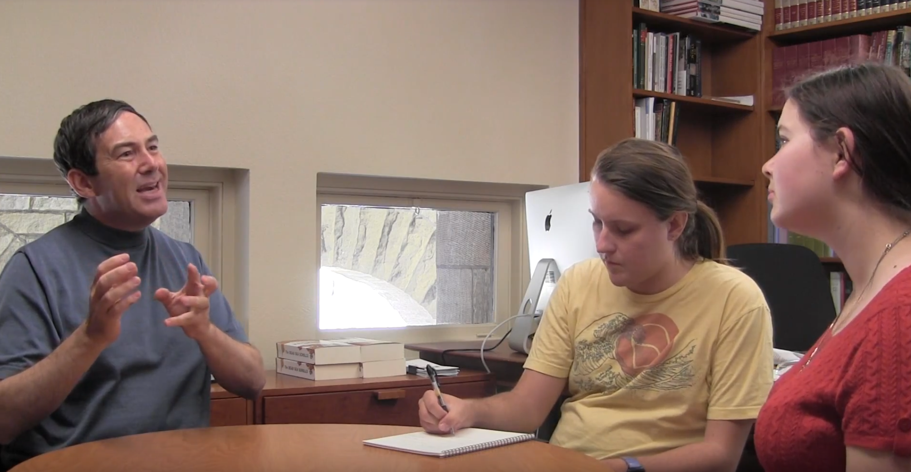
“I’m … dependent on my students’ facial expressions, their gestures, their body language. And if they’re all staring into the screen, I lose all of it.”
Notes:
PICTURES AND QUOTES GO HERE

Slide 16
Say
Think
Tech must decrease time cost or increase effectiveness of collaboration
Human attention spans are short
“I’m … dependent on my students’ facial expressions, their gestures, their body language. And if they’re all staring into the screen, I lose all of it.”
Cost benefit analysis of tech
His positions are research-backed
“Lecturettes” interspersed with activities
Used variety of media
Passionate about effective education
Collaborative assignments
Paranoid students are surfing the web
Do
Feel

Slide 17
Alice
17, white, female, high school senior
Notes:
Participant Profile Slide

Slide 18
“If I can do something analog, I try to do it analog”

Slide 19
Say
Think
“Because I’m not tech savvy, the more consolidated it is, the more I’m inclined to use it.”
Putting personal info or photos online is dangerous
“Either all teachers have to use it or all teachers don’t use it.”
It’s convenient when everything is in consistent, consolidated, and straightforward
“If I can do something analog, I try to do it analog”
I don’t need tech for everything
Comforted by lack of phones in class, nobody recording her
Deleted Facebook account
Frustrated by inconsistent tech requirements
Organizes schoolwork in a physical journal
Uses a group text to coordinate on group projects
Worried about privacy and security online
Do
Feel

Slide 20
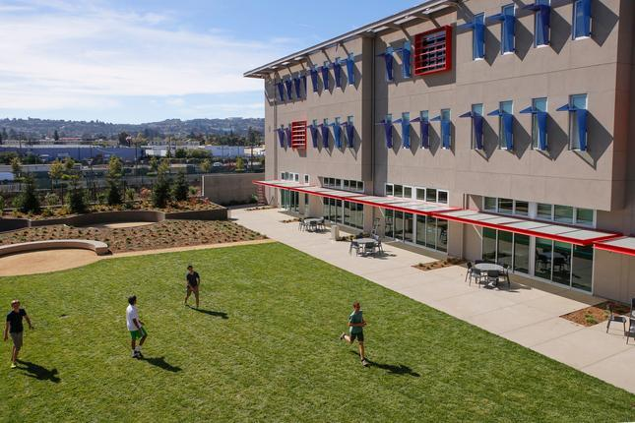
Arthur
Technology director at a private K-12 school
(Middle age, Asian-American male)
Notes:
Participant Profile Slide
David’s former boss
Image source: Mercury News (not stock, it’s the actual school)

Slide 21
“[The] golden fleece is one system that is modular enough to do everything a school wants to do.”

Slide 22
Say
Think
Building the “best of breed” network infrastructure is at “the core of edtech”.
A key challenge is distraction with the laptops--tension between training students’ self-discipline, and restricting them with rules
“I’m not that interested in one-off products… [the] golden fleece is one system that is modular enough to do everything a school wants to do.”
Runs the IT infrastructure for large, multi-campus private school
Proud of the school’s accomplishments
Manages large group of employees and interns
Optimistic about Canvas & Google Cloud
Frustrated; preferred grading application was destroyed by greedy competitor
Oversees 1:1 laptop program starting in 5th grade
Do
Feel

Slide 23
Insights &
Needs

Slide 24
Insight: People prefer consolidated solutions
Need: Technology must be simple and centralized

Slide 25
Insight: Instructors and students are reluctant to use technology
Need: Technology must clearly justify its own use

Slide 26
Insight: Instructors rely on body language and facial expression
Need: Technology must not get in the way of body language, or otherwise provide feedback
Notes:
This is a great open ended question

Slide 27
We want to see the kids interacting with the toys, not just pushing a button and passively listening.
- Participant 1 (Paraphrased)

Slide 28
Insight: Instructors and students prefer physical and tactile learning
Need: Technology must somehow replicate or supplement this tactile element

Slide 29
Summary
How to replicate the tactile and interactive nature of analog?
How to not impede or to replicate body language feedback?
Going forward, have more diverse interviewees

Slide 30
Questions?

Slide 31
Detailed
empathy maps

Slide 32
Say
Alice 6
“Teachers will generally guide discussions, but she tries not to because she wants it to be very organic, which I really enjoy”
“In humanities … I enjoy discussion, but in science and math I like to be lectured at”
“I have one teacher this year who is kind of old fashioned and doesn’t use [schoology] and it’s kind of frustrating because the only way we get the information of what we’re supposed to do is at the end of class he’ll flippantly mention it”
“Because I’m not tech savvy, the more consolidated it is, the more I’m inclined to use it.”
“I don’t trust google as a company”
“I’ve definitely seen people posting people doing dumb stuff on their stories without people knowing and I’m always like that’s not cool”
“Having something I can write in is very important and refer back to throughout the week. I find that even apple calendar is very clunky and I’m not super inclined to go and put every assignment I have to do in a digital app cause I don’t think it’s effective”
“I try to minimize the amount of tech I have, just cause it freaks me out ... cause I don’t know exactly what’s happening”
“If I can do something analog, I try to do it analog, and if I can avoid making an account, I avoid making the account cause it seems easier to me not to do that”
“I’ve been raised to not put a ton out there”
“I expect that I log on and all of my assignments will be there”
“I feel like it has to be one way or the other, either all teachers have to use it or all teachers don’t use it. The mixing of the two systems is kind of wonky”
“I don’t even know who our principal is now. I’ve had 3 or 4 in the time I’ve been there.”
“The school based schedule has literally been different for me every single year since I’ve been in high school, which is kind of just annoying and inconsistent.”

Slide 33
Think
My account might get hacked
Photos I put online could leak
Someone might be recording me in class
It’s convenient when I can find everything in one place
I wish different teachers would be more consistent about what tech they use
I just want the system to be simple and intuitive
I don’t need to use tech for everything
Putting personal info in tech just isn’t safe
I’m willing to try different subjects, even if they frustrate me
Different subjects need different teaching styles

Slide 34
Deleted facebook account
Doesn’t put pics on google drive
Organizes schoolwork in a physical journal
Required to bring a laptop to school everyday, uses laptop for homework too
Communicates with teammates via a group text
Fiddles with her thumbs when thinking, discussing uncomfortable subjects
Avoids discussing uncomfortable subjects by saying “you’ve probably heard about it,” doesn’t get into specifics unless prompted to
Looks at me when hearing question, looks around the room while answering
Users hand gestures to illustrate points (actions, tech use, descriptions)
Trails off with “I don’t know” or “yeah” when running out of things to say
Do

Slide 35
Worried (about privacy)
Anxious
freaked out
Frustrated (at low tech teacher)
Awestruck (by advancing tech)
Uncertain (about school bureaucracy)
Involved (in class discussions)
DIY spirit (using journal for homework)
Comforted (by no phones in class)
Satisfied (with current low tech solutions)
Distrusting (of tech companies)
Feel

Slide 36
Say
John & Mark 2 & 3
“I don’t have computers, I don’t do work.”
“Do I have a phone? That doesn’t make any sense! No I don’t have a phone.”
Doesn’t know how to use a phone
Doesn’t know the passcode
[Would use a computer for] “Mostly songs.”
Listening to music while drawing is “ kind of annoying.”
(Do you use your computer when you’re doing homework?) “I kinda think of that as cheating … Well, it’s not cheating necessarily, but I kinda like doing everything in my head … I like to challenge myself.”
(What do you do on your computer?) “Just play music and . . . work on projects. We’re going to Japan. We research it and I do some research ... what places to go and what are the best train routes.”
“I really like engineering, like designing stuff and then building it.”
About Tinkercad:
“It’s really really interesting to find out what you can make. ‘Cause every time I use it I find out something else that you can do with it.”
Just recently figured out how to rotate items

Slide 37
Think
Associates having a computer with having a job/having homework
5 is to young to have a phone
It’s more impressive to do work in your head / without reviewing
Ability to memorize is important
Memorizes the recipes his mom teaches him
Likes to try to do his math homework
It’s useful to have a centralized place to review information
Digital can be slow for building as opposed to analog, analog is easier to explore creatively
e.g. Tinkercad vs. Lego
Computers are useful for finding information quickly

Slide 38
Fidgeted throughout the interview
Crossing and uncrossing legs
Fiddling with blind rope
Playing with pants cuffs
Spelled out his name after telling it to me
Draws pictures of animals for his mom
Plays with building toys
Legos
Meticulously sorted by set, function, color, etc.
Magnetiles (“Like cubes with little magnets in them.”
Uses Tinkercad to do 3D modeling (i.e. building) online
Learns new features by exploring the tool, not by using tutorials
Learns recipes from his mom and cooks them from memory
Helps research for family trips on his computer
Destinations
Best travel routes
Do

Slide 39
Generally:
Bored
Energetic
Affectionate towards family
Proud of learning to spell
Knowledgeable
Curious
Likes exploring and discovering new features of technologies
Likes knowing he has access to class information and review materials
Proud of his memory skills
Feel

Slide 40
Say
Think
Tech must decrease time cost or increase effectiveness of collaboration
Human attention spans are short
“I’m … dependent on my students’ facial expressions, their gestures, their body language. And if they’re all staring into the screen, I lose all of it.”
Cost benefit analysis of tech
His positions are research-backed
“Lecturettes” interspersed with activities
Used variety of media
Passionate about effective education
Collaborative assignments
Paranoid students are surfing the web
Do
Feel

Slide 41
Say
Gabriel
Tech must decrease time cost or increase effectiveness of collaboration
“I’m … dependent on my students’ facial expressions, their gestures, their body language. And if they’re all staring into the screen, I lose all of it.”
Used the phrase “lecturettes”
Has been teaching for ~25 years, ~2 of them at Stanford
Long lectures = bad
He uses ‘interactive lectures’
Mentioned tech like google docs, trello, skype, dropbox, bibliographic software, footnote databases
Said comparing his prior teaching (at a liberal arts college) to stanford was like “martians vs. venusians” in regards to student/faculty culture
“Wonderfully overwhelmed by just the sheer brilliance on this campus”
“Intimidating but energizing” in regards to campus culture
Some students go to office hours often, others rarely, there’s a gap there

Slide 42
Think
Gabriel
Analyzed tech in a cost-benefit analysis
Human attention spans are short
His positions are research-backed
Thinks of having a variety of instruction forms works as an equalizer of sorts
His handwriting is bad
Considers pdf readers to be bad for navigation
Thinks it’s odd the school has financial support for books but not printing
Considers Evernote in high regard

Slide 43
Gabriel
“Lecturettes” interspersed with activities
Max lengths of lectures ~8 minutes
“Scroll activity” where student reach under their seats and find a text to analyze
Online polls
Small table activities
Assigned collaborative assignments
Chose high-tech classrooms
Disallowed laptops and electronics in class
Teaches a graduate class of pedagogy
~2 hour lectures, 7-9 activities in that period
Uses variety of materials (physical, slides, video, graphics, texts, etc)
Emphatic hand gestures
Do

Slide 44
Gabriel
Intimidated by stanford students
Paranoid students are surfing the internet instead of paying attention
Passionate about education and effective pedagogy
Worried that if a student has a learning exception need for technology, that outs them as having some disability
Sorry that all his printing (because no laptops) kills a lot of trees
Concerned that requiring printing is a financial cost to students
Excited whenever tech can save him time
Also excited for anything that facilitates collaboration
Was surprised (a while ago) when students working on a collaborative paper used a large monitor to work together (which was novel at the time)
Spurred him to be more innovative
Unsure at how to drive attendance to office hours
In regards to being at stanford, feels “like he just got out of grad school”
Feel

